Slide 1
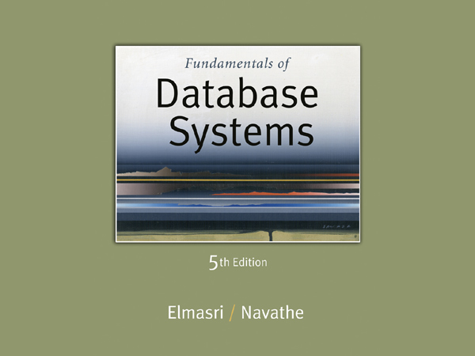

Slide 2
Chapter 3
Data Modeling Using the Entity-Relationship (ER) Model
+
SQL Basics

Slide 3
Chapter Outline
Overview of Database Design Process
Example Database Application (COMPANY)
ER Model Concepts
Entities and Attributes
Entity Types, Value Sets, and Key Attributes
Relationships and Relationship Types
Weak Entity Types
Roles and Attributes in Relationship Types
ER Diagrams - Notation
ER Diagram for COMPANY Schema
Alternative Notations – UML class diagrams, others

Slide 4
Overview of Database Design Process
Two main activities:
Database design
Applications design
Focus in this chapter on database design
To design the conceptual schema for a database application
Applications design focuses on the programs and interfaces that access the database
Generally considered part of software engineering

Slide 5
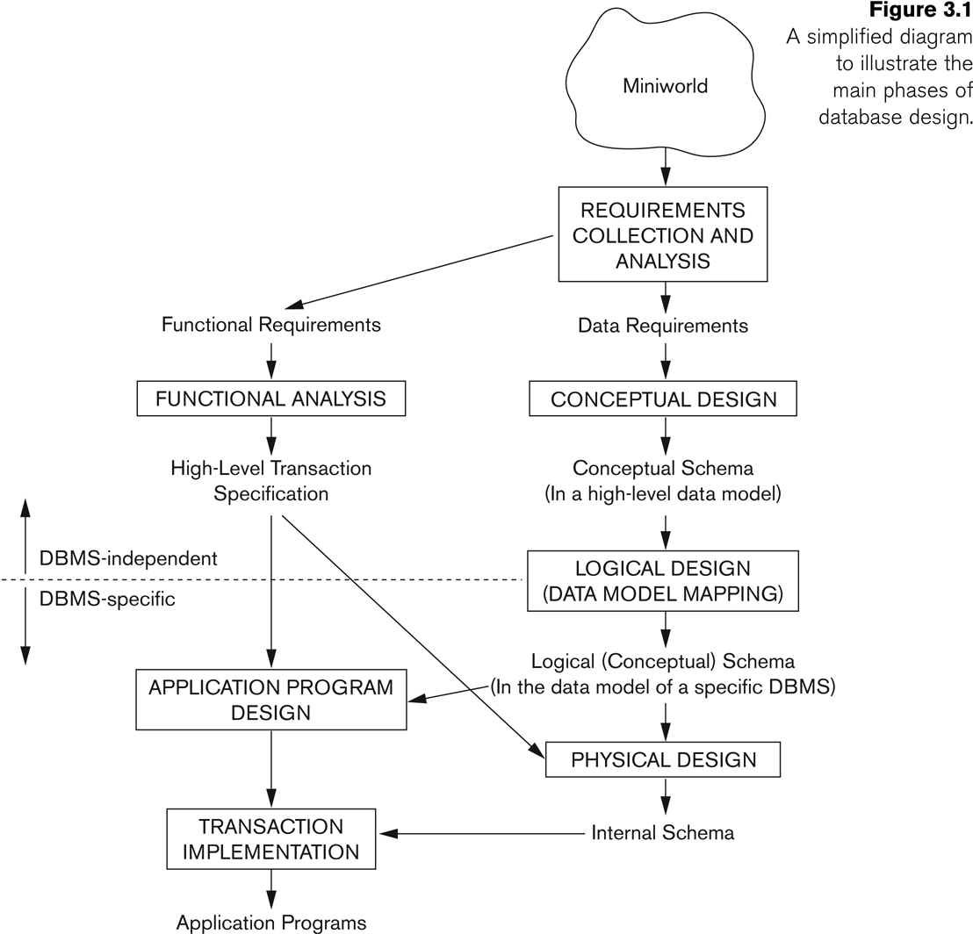
Overview of Database Design Process

Slide 6
Writing Exercise

Slide 7
Example COMPANY Database
We need to create a database schema design based on the following (simplified) requirements of the COMPANY Database:
The company is organized into DEPARTMENTs. Each department has a name, number and an employee who manages the department. We keep track of the start date of the department manager. A department may have several locations.
Each department controls a number of PROJECTs. Each project has a unique name, unique number and is located at a single location.

Slide 8
Example COMPANY Database (Contd.)
We store each EMPLOYEE’s social security number, address, salary, gender, and birthdate.
Each employee works for one department but may work on several projects.
We keep track of the number of hours per week that an employee currently works on each project.
We also keep track of the direct supervisor of each employee.
Each employee may have a number of DEPENDENTs.
For each dependent, we keep track of their name, gender, birthdate, and relationship to the employee.

Slide 9
ER Model Concepts
Entities and Attributes
Entities are specific objects or things in the mini-world that are represented in the database.
For example the EMPLOYEE John Smith, the Research DEPARTMENT, the ProductX PROJECT
Attributes are properties used to describe an entity.
For example an EMPLOYEE entity may have the attributes Name, SSN, Address, Gender, BirthDate
A specific entity will have a value for each of its attributes.
For example a specific employee entity may have Name='John Smith', SSN='123456789', Address ='731, Fondren, Houston, TX’, Gender='M', BirthDate='09-JAN-55‘
Each attribute has a value set (or data type) associated with it – e.g. integer, string, subrange, enumerated type, …

Slide 10
Types of Attributes (1)
Simple
Each entity has a single atomic value for the attribute. For example, SSN or Gender.
Composite
The attribute may be composed of several components. For example:
Address(Apt#, House#, Street, City, State, ZipCode, Country), or
Name(FirstName, MiddleName, LastName).
Composition may form a hierarchy where some components are themselves composite.
Multi-valued
An entity may have multiple values for that attribute. For example, Color of a CAR or PreviousDegrees of a STUDENT.
Denoted as {Color} or {PreviousDegrees}.

Slide 11
Types of Attributes (2)
In general, composite and multi-valued attributes may be nested arbitrarily to any number of levels, although this is rare.
For example, PreviousDegrees of a STUDENT is a composite multi-valued attribute denoted by {PreviousDegrees (College, Year, Degree, Field)}
Multiple PreviousDegrees values can exist
Each has four subcomponent attributes:
College, Year, Degree, Field

Slide 12
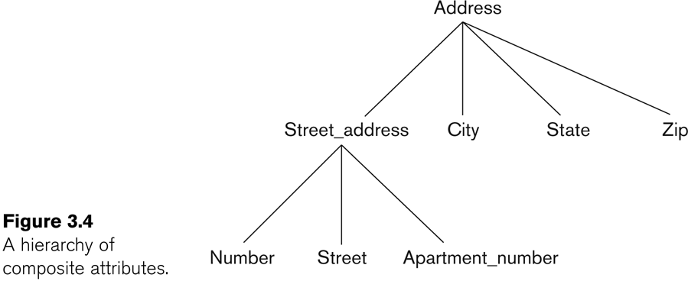
Example of a composite attribute

Slide 13
Entity Types and Key Attributes (1)
Entities with the same basic attributes are grouped or typed into an entity type.
For example, the entity type EMPLOYEE and PROJECT.
An attribute of an entity type for which each entity must have a unique value is called a key attribute of the entity type.
For example, SSN of EMPLOYEE.

Slide 14
Entity Types and Key Attributes (2)
A key attribute may be composite.
VehicleTagNumber is a key of the CAR entity type with components (Number, State).
An entity type may have more than one key.
The CAR entity type may have two keys:
VehicleIdentificationNumber (popularly called VIN)
VehicleTagNumber (Number, State), aka license plate number.
Each key is underlined

Slide 15
Displaying an Entity type
In ER diagrams, an entity type is displayed in a rectangular box
Attributes are displayed in ovals
Each attribute is connected to its entity type
Components of a composite attribute are connected to the oval representing the composite attribute
Each key attribute is underlined
Multivalued attributes displayed in double ovals
See CAR example on next slide

Slide 16
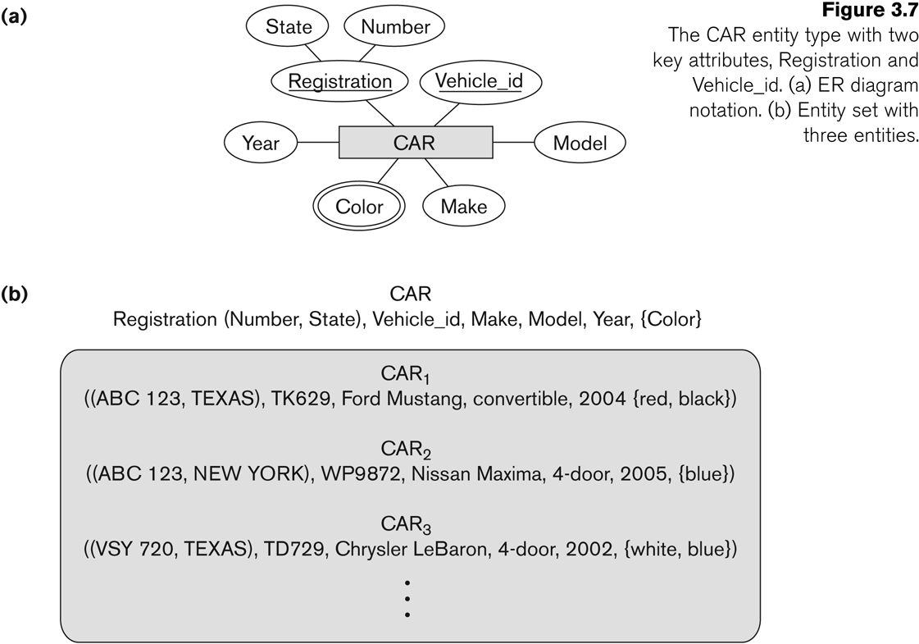
Entity Type CAR with two keys and a corresponding Entity Set

Slide 17

Lets do Some Hands-on
Practice on your Systems Now along with me

Slide 18
Basic SQL
SQL language
Considered one of the major reasons for the commercial success of relational databases
SQL
Structured Query Language
Statements for data definitions, queries, and updates (both DDL and DML)
Core specification
Plus specialized extensions

Slide 19
SQL Data Definition and Data Types
Terminology:
Table, row, and column used for relational model terms relation, tuple, and attribute
CREATE statement
Main SQL command for data definition

Slide 20
Attribute Data Types and Domains in SQL
Basic data types
Numeric data types
Integer numbers: INTEGER, INT, and SMALLINT
Floating-point (real) numbers: FLOAT or REAL, and
DOUBLE PRECISION
Character-string data types
Fixed length: CHAR(n), CHARACTER(n)
Varying length: VARCHAR(n), CHAR VARYING(n), CHARACTER VARYING(n)

Slide 21
Attribute Data Types and Domains in SQL (cont’d.)
Bit-string data types
Fixed length: BIT(n)
Varying length: BIT VARYING(n)
Boolean data type
Values of TRUE or FALSE
DATE data type
Ten positions
or NULL
Components are YEAR, MONTH, and DAY
YYYY-MM-DD
in the form

Slide 22
Attribute Data Types and Domains in SQL (cont’d.)
Additional data types
Timestamp data type (TIMESTAMP)
Includes the DATE and TIME fields
Plus a minimum of six positions for decimal fractions of seconds
Optional WITH TIME ZONE qualifier
INTERVAL data type
Specifies a relative value that can be used to increment or decrement an absolute value of a date, time, or timestamp

Slide 23
Data Definition, Constraints, and Schema Changes
Used to CREATE, DROP, and ALTER the descriptions of the tables (relations) of a database

Slide 24
CREATE TABLE
Specifies a new base relation by giving it a name, and specifying each of its attributes and their data types (INTEGER, FLOAT, DECIMAL(i,j), CHAR(n), VARCHAR(n))
A constraint NOT NULL may be specified on an attribute CREATE TABLE DEPARTMENT ( DNAME VARCHAR(10) NOT NULL, DNUMBER INTEGER NOT NULL, MGRSSN CHAR(9), MGRSTARTDATE CHAR(9) );

Slide 25
CREATE TABLE
In SQL2, can use the CREATE TABLE command for specifying the primary key attributes, secondary keys, and referential integrity constraints (foreign keys).
Key attributes can be specified via the PRIMARY KEY and UNIQUE phrases
CREATE TABLE DEPT (
DNAME VARCHAR(10) NOT NULL,
DNUMBER INTEGER NOT NULL,
MGRSSN CHAR(9),
MGRSTARTDATE CHAR(9),
PRIMARY KEY (DNUMBER),
UNIQUE (DNAME),
FOREIGN KEY (MGRSSN) REFERENCES EMP );

Slide 26
DROP TABLE
Used to remove a relation (base table) and its definition
The relation can no longer be used in queries, updates, or any other commands since its description no longer exists
Example: DROP TABLE DEPENDENT;

Slide 27
ALTER TABLE
Used to add an attribute to one of the base relations
The new attribute will have NULLs in all the tuples of the relation right after the command is executed; hence, the NOT NULL constraint is not allowed for such an attribute
Example: ALTER TABLE EMPLOYEE ADD JOB VARCHAR(12);
The database users must still enter a value for the new attribute JOB for each EMPLOYEE tuple.
This can be done using the UPDATE command.

Slide 28

Lets Get Back to Conceptual Discussion

Slide 29
Entity Set
Each entity type will have a collection of entities stored in the database
Called the entity set
Previous slide shows three CAR entity instances in the entity set for CAR
Same name (CAR) used to refer to both the entity type and the entity set
Entity set is the current state of the entities of that type that are stored in the database

Slide 30
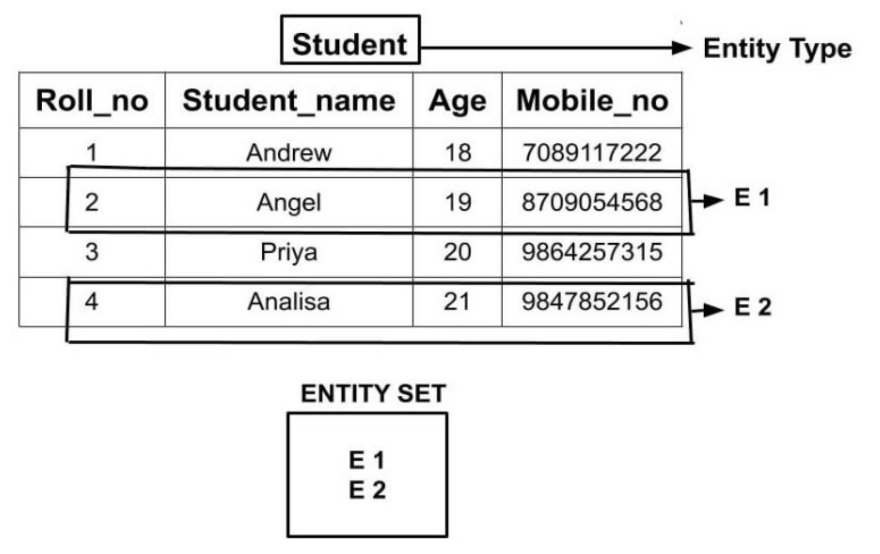
Entity Set
Entity Set is a collection of entities of the same entity type

Slide 31
Initial Design of Entity Types for the COMPANY Database Schema
Based on the requirements, we can identify four initial entity types in the COMPANY database:
DEPARTMENT
PROJECT
EMPLOYEE
DEPENDENT
Their initial design is shown on the following slide
The initial attributes shown are derived from the requirements description

Slide 32
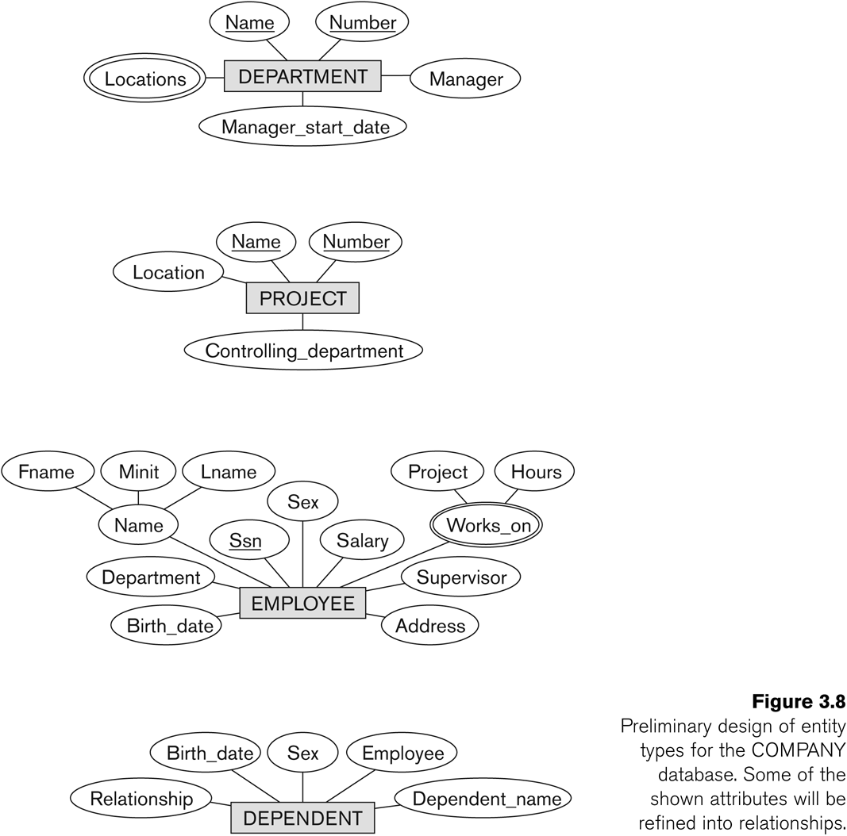
Initial Design of Entity Types: EMPLOYEE, DEPARTMENT, PROJECT, DEPENDENT

Slide 33
Refining the initial design by introducing relationships
The initial design is typically not complete
Some aspects in the requirements will be represented as relationships
ER model has three main concepts:
Entities (and their entity types and entity sets)
Attributes (simple, composite, multivalued)
Relationships (and their relationship types and relationship sets)
We introduce relationship concepts next

Slide 34
Relationships
Introduction to Relationship Types +
Relationship types and Instances +
Role names and Relation types +
Role names and Recursive Relationship types +
Constraints on Relationship Types +
Attributes of Relationship Types +
Relationship Representation in ER Diagram +
Higher Degree Relationships +
Examples +

Slide 35
Introduction to Relationship Type
By reviewing the initial design of the COMPANY DB example we can see the following:
Some attributes of an entity reference other attributes in the same or other entities. For example, The attribute Department of the EMPLOYEE entity type refers to the DEPARTMENT entity that the employee works for.
These are implicit relationships that exist between entity types.
A better representation will be obtained if these are represented as relationships between the entity types rather than linking attributes.
Here we will describe another major component of ER model; namely relationships.
We will discuss relationship types, instances, degrees, and constraints on relationships.

Slide 36
Relationship Types and Instances…
Informally, a relationship type is a meaningful association among entity types.
A relationship (instance) is an association of entities where the association includes one entity from each participating entity type.
Mathematically, a relationship type (set) R between entity types E1, E2, …, En is a set of relationship instance ri, where each ri associates n individual entities (e1, e2, …, en); and each entity ei, in ri, is a member of the entity type Ej, 1<= j <= n.

Slide 37
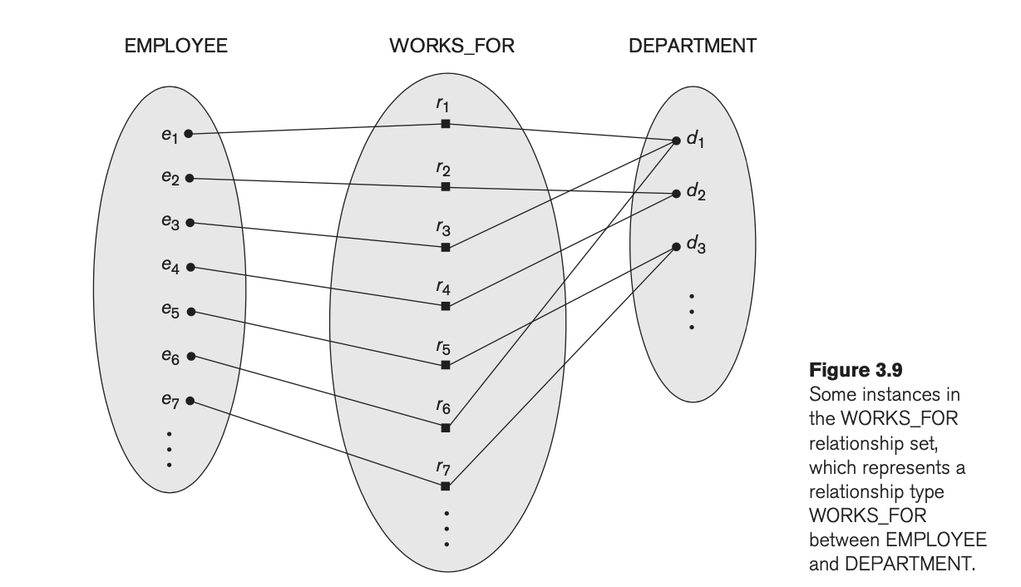
Example

Slide 38
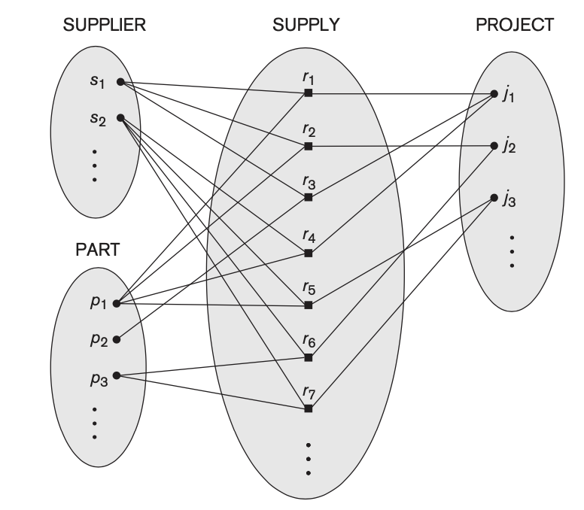
Degree of a Relationship Type
The degree of a relationship type is the number of participating entity types
A relationship type of degree one is called unary (to be discussed more)
A relationship type of degree two is called binary
A relationship type of degree two is called ternary
Example of Degree Binary relationship: WORKS_FOR (previous slide)
Example of Degree Ternary relationship: SUPPLY (below image)

Slide 39
Degree of Relationship
Binary
Teacher teaches a subject
Unary (to be discussed more)
Subjects may be prerequisites for other subjects
Ternary
which teachers taught which subjects in which courses

Slide 40
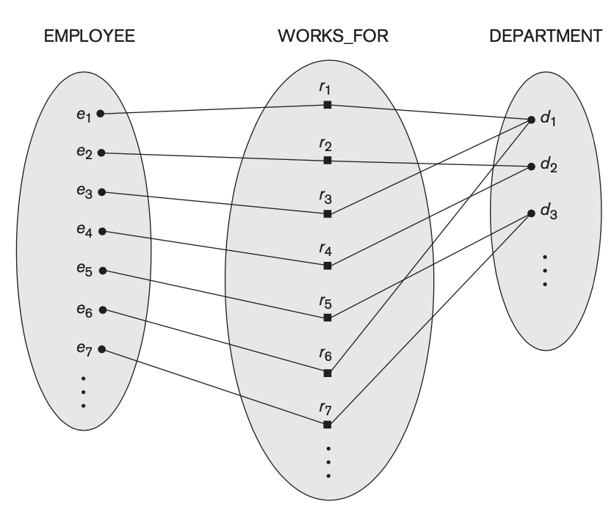
Relationships as Attributes
Consider the WORKS_FOR relationship type
Two Alternatives to store relationship as attribute
think of an attribute called Department of the EMPLOYEE entity type, where the value of Department for each EMPLOYEE entity is (a reference to) the DEPARTMENT entity for which that employee works.
value set for this Department attribute is the set of all DEPARTMENT entities

Slide 41
Relationships as Attributes
Consider the WORKS_FOR relationship type
Two Alternatives to store relationship as attribute
think of a multivalued attribute Employees of the entity type DEPARTMENT whose value for each DEPARTMENT entity is the set of EMPLOYEE entities who work for that department.

Slide 42

Lets Do Some Hands-On
Do the Practice right now along with me

Slide 43
Specifying Updates in SQL
There are three SQL commands to modify the database: INSERT, DELETE, and UPDATE

Slide 44
INSERT
In its simplest form, it is used to add one or more tuples to a relation
Attribute values should be listed in the same order as the attributes were specified in the CREATE TABLE command

Slide 45
INSERT (contd.)
Example:
U1: INSERT INTO EMPLOYEE VALUES ('Richard','K','Marini', '653298653', '30-DEC-52', '98 Oak Forest,Katy,TX', 'M', 37000,'987654321', 4 )
An alternate form of INSERT specifies explicitly the attribute names that correspond to the values in the new tuple
Attributes with NULL values can be left out
Example: Insert a tuple for a new EMPLOYEE for whom we only know the FNAME, LNAME, and SSN attributes.
U1A: INSERT INTO EMPLOYEE (FNAME, LNAME, SSN) VALUES ('Richard', 'Marini', '653298653')

Slide 46
INSERT (contd.)
Important Note: Only the constraints specified in the DDL commands are automatically enforced by the DBMS when updates are applied to the database
Another variation of INSERT allows insertion of multiple tuples resulting from a query into a relation

Slide 47
INSERT (contd.)
Example: Suppose we want to create a temporary table that has the name, number of employees, and total salaries for each department.
A table DEPTS_INFO is created by U3A, and is loaded with the summary information retrieved from the database by the query in U3B.
U3A: CREATE TABLE DEPTS_INFO (DEPT_NAME VARCHAR(10), NO_OF_EMPS INTEGER, TOTAL_SAL INTEGER);
U3B: INSERT INTO DEPTS_INFO (DEPT_NAME, NO_OF_EMPS, TOTAL_SAL) SELECT DNAME, COUNT (*), SUM (SALARY) FROM DEPARTMENT, EMPLOYEE WHERE DNUMBER=DNO GROUP BY DNAME ;

Slide 48
INSERT (contd.)
Note: The DEPTS_INFO table may not be up-to-date if we change the tuples in either the DEPARTMENT or the EMPLOYEE relations after issuing U3B. We have to create a view (see later) to keep such a table up to date.

Slide 49
DELETE
Removes tuples from a relation
Includes a WHERE-clause to select the tuples to be deleted
Referential integrity should be enforced
Tuples are deleted from only one table at a time (unless CASCADE is specified on a referential integrity constraint)
A missing WHERE-clause specifies that all tuples in the relation are to be deleted; the table then becomes an empty table
The number of tuples deleted depends on the number of tuples in the relation that satisfy the WHERE-clause

Slide 50
DELETE (contd.)
Examples:
U4A: DELETE FROM EMPLOYEE WHERE LNAME='Brown’
U4B: DELETE FROM EMPLOYEE WHERE SSN='123456789’
U4C: DELETE FROM EMPLOYEE WHERE DNO IN (SELECT DNUMBER FROM DEPARTMENT WHERE DNAME='Research')
U4D: DELETE FROM EMPLOYEE

Slide 51
UPDATE
Used to modify attribute values of one or more selected tuples
A WHERE-clause selects the tuples to be modified
An additional SET-clause specifies the attributes to be modified and their new values
Each command modifies tuples in the same relation
Referential integrity should be enforced

Slide 52
UPDATE (contd.)
Example: Change the location and controlling department number of project number 10 to 'Bellaire' and 5, respectively.
U5: UPDATE PROJECT SET PLOCATION = 'Bellaire', DNUM = 5 WHERE PNUMBER=10

Slide 53
UPDATE (contd.)
Example: Give all employees in the 'Research' department a 10% raise in salary.
U6: UPDATE EMPLOYEE SET SALARY = SALARY *1.1 WHERE DNO IN (SELECT DNUMBER FROM DEPARTMENT WHERE DNAME='Research')
In this request, the modified SALARY value depends on the original SALARY value in each tuple
The reference to the SALARY attribute on the right of = refers to the old SALARY value before modification
The reference to the SALARY attribute on the left of = refers to the new SALARY value after modification

Slide 54
Recap of SQL Queries
A query in SQL can consist of up to six clauses, but only the first two, SELECT and FROM, are mandatory. The clauses are specified in the following order: SELECT <attribute list> FROM <table list> [WHERE <condition>] [GROUP BY <grouping attribute(s)>] [HAVING <group condition>] [ORDER BY <attribute list>]
There are three SQL commands to modify the database: INSERT, DELETE, and UPDATE

Slide 55
Retrieval Queries in SQL
SQL has one basic statement for retrieving information from a database; the SELECT statement
This is not the same as the SELECT operation of the relational algebra
Important distinction between SQL and the formal relational model:
SQL allows a table (relation) to have two or more tuples that are identical in all their attribute values
Hence, an SQL relation (table) is a multi-set (sometimes called a bag) of tuples; it is not a set of tuples
SQL relations can be constrained to be sets by specifying PRIMARY KEY or UNIQUE attributes, or by using the DISTINCT option in a query

Slide 56
Retrieval Queries in SQL (contd.)
A bag or multi-set is like a set, but an element may appear more than once.
Example: {A, B, C, A} is a bag. {A, B, C} is also a bag that also is a set.
Bags also resemble lists, but the order is irrelevant in a bag.
Example:
{A, B, A} = {B, A, A} as bags
However, [A, B, A] is not equal to [B, A, A] as lists

Slide 57
Retrieval Queries in SQL (contd.)
Basic form of the SQL SELECT statement is called a mapping or a SELECT-FROM-WHERE block
SELECT <attribute list>
FROM <table list>
WHERE <condition>
<attribute list> is a list of attribute names whose values are to be retrieved by the query
<table list> is a list of the relation names required to process the query
<condition> is a conditional (Boolean) expression that identifies the tuples to be retrieved by the query

Slide 58
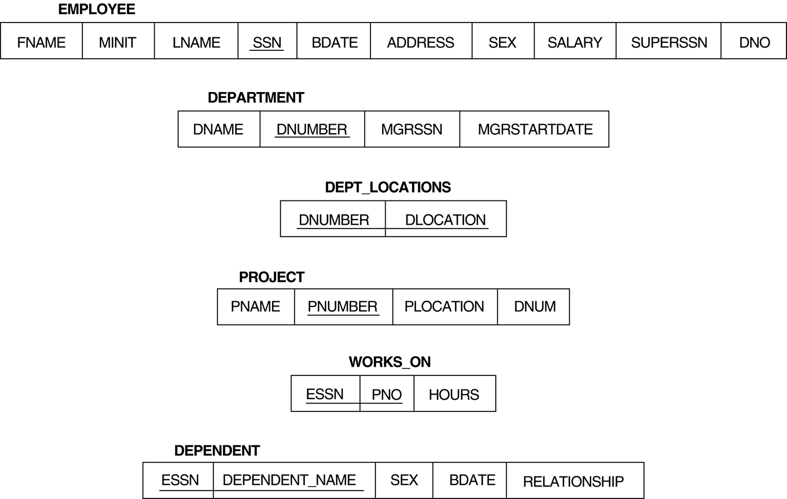
Relational Database Schema--Figure 5.5

Slide 59
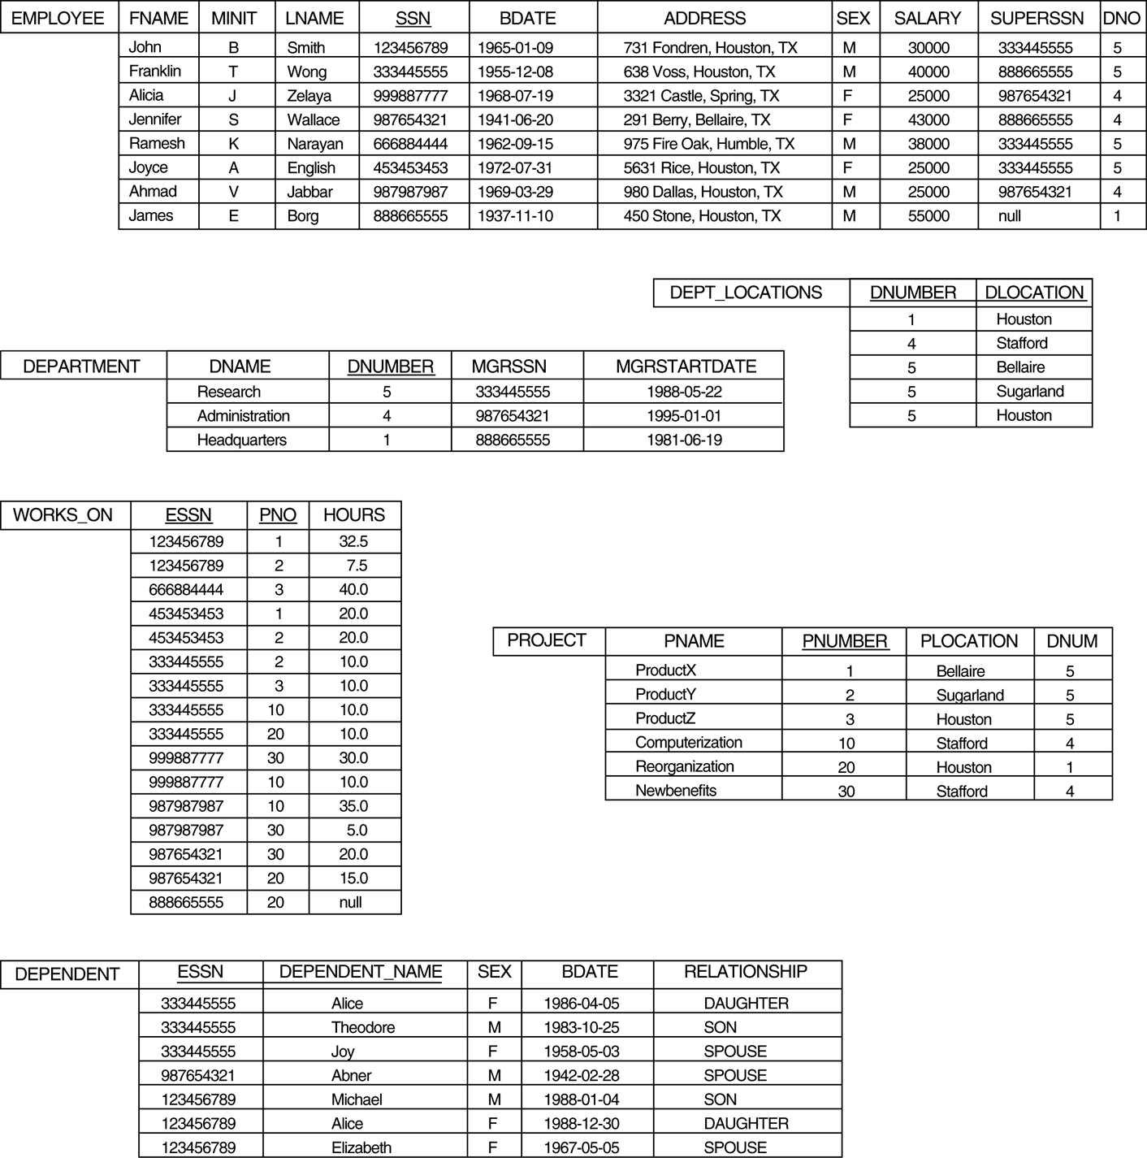
Populated Database--Fig.5.6

Slide 60
Simple SQL Queries
Basic SQL queries correspond to using the following operations of the relational algebra:
SELECT
PROJECT
JOIN
All subsequent examples use the COMPANY database

Slide 61
Simple SQL Queries (contd.)
Example of a simple query on one relation
Query 0: Retrieve the birthdate and address of the employee whose name is 'John B. Smith'.
Q0: SELECT BDATE, ADDRESS FROM EMPLOYEE WHERE FNAME='John' AND MINIT='B’ AND LNAME='Smith’
Similar to a SELECT-PROJECT pair of relational algebra operations:
The SELECT-clause specifies the projection attributes and the WHERE-clause specifies the selection condition
However, the result of the query may contain duplicate tuples

Slide 62
Simple SQL Queries (contd.)
Query 1: Retrieve the name and address of all employees who work for the 'Research' department.
Q1: SELECT FNAME, LNAME, ADDRESS FROM EMPLOYEE, DEPARTMENT WHERE DNAME='Research' AND DNUMBER=DNO
Similar to a SELECT-PROJECT-JOIN sequence of relational algebra operations
(DNAME='Research') is a selection condition (corresponds to a SELECT operation in relational algebra)
(DNUMBER=DNO) is a join condition (corresponds to a JOIN operation in relational algebra)

Slide 63
Simple SQL Queries (contd.)
Query 2: For every project located in 'Stafford', list the project number, the controlling department number, and the department manager's last name, address, and birthdate.
Q2: SELECT PNUMBER, DNUM, LNAME, BDATE, ADDRESS FROM PROJECT, DEPARTMENT, EMPLOYEE WHERE DNUM=DNUMBER AND MGRSSN=SSN AND PLOCATION='Stafford'
In Q2, there are two join conditions
The join condition DNUM=DNUMBER relates a project to its controlling department
The join condition MGRSSN=SSN relates the controlling department to the employee who manages that department

Slide 64

Lets Go Back to Conceptual Discussion
Remaining Topics

Slide 65
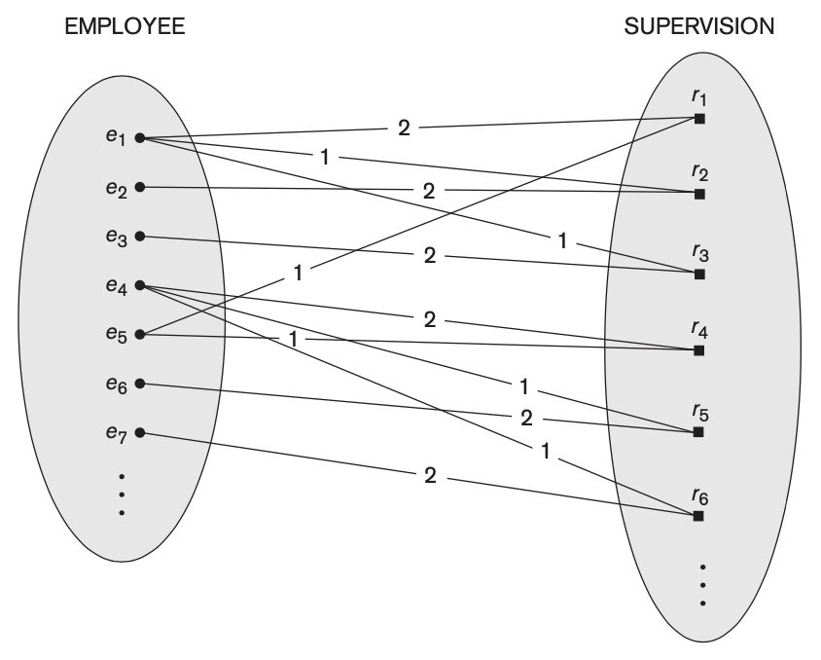
Recursive Relationship and Role Names
in some cases the same entity type participates more than once in a relationship type in different roles.
In such cases the role name becomes essential for distinguishing the meaning of the role that each participating entity plays
The SUPERVISION relationship type relates an employee to a supervisor, where both employee and supervisor entities are members of the same EMPLOYEE entity set
the EMPLOYEE entity type participates twice in SUPERVISION: once in the role of supervisor (or boss), and once in the role of supervisee (or subordinate)

Slide 66
Recursive Relationship and Role Names
Each relationship instance r_i in SUPERVISION associates two different employee entities e_j and e_k, one of which plays the role of supervisor and the other the role of supervisee.
lines marked ‘1’ represent the supervisor role, and those marked ‘2’ represent the supervisee role
Example
e1 supervises e2 and e3
e4 supervises e6 and e7
e5 supervises e1 and e4

Slide 67
Department & Employee
Consider Employees are working in departments:
Department
Employee
Manager/ Boss??
Employees are belong to Departments
Some employees are managers of department
Employee may work in more than one dept
Some are managers of other employees
Entities
Relationships
Notes:
Manager is a job title, it is not an Entity rather it is managed inside Employee

Slide 68
Basic Examples
MANAGES
EMPLOYEE
DEPARTMENT
BELONGS TO
Employee
DEPARTMENT
MANAGES
EMPLOYEE
DEPARTMENT
BELONGS TO

Slide 69
Basic Examples …
Offered with
Course
Book
Hours
WORKS_ON
EMPLOYEE
PROJECT

Slide 70
More Basic Examples
drives
Person
Car
owns
Person
Car

Slide 71
Constraints on Binary Relationship Types
Relationship types usually have certain constraints that limit the possible combinations of entities that may participate in the corresponding relationship set.
Example
if the company has a rule that each employee must work for exactly one department, then we would like to describe this constraint in the schema
Two main types of binary relationship constraints
cardinality ratio
participation

Slide 72
Cardinality Ratios for Binary Relationships
Specifies the maximum number of relationship instances that an entity can participate in
Example
in the WORKS_FOR binary relationship type, DEPARTMENT:EMPLOYEE is of cardinality ratio 1:N, meaning that each department can be related to (that is, employs) any number of employees (N), but an employee can be related to (work for) at most one department (1)
Example of 1:N relationship

Slide 73
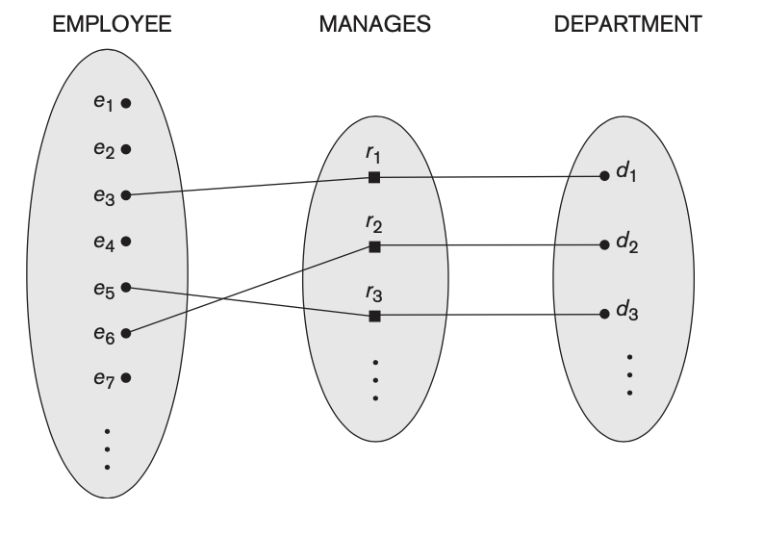
Cardinality Ratios for Binary Relationships
Example of 1:1 relationship
relates a department entity to the employee who manages that department.
at any point in time—an employee can manage at most one department and a department can have at most one manager

Slide 74
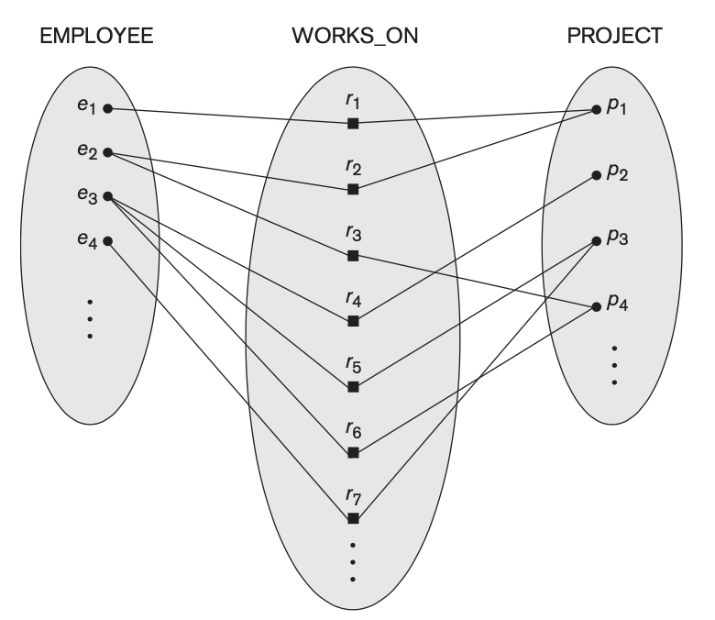
Cardinality Ratios for Binary Relationships
Example of M:N relationship
an employee can work on several projects and a project can have several employees.

Slide 75
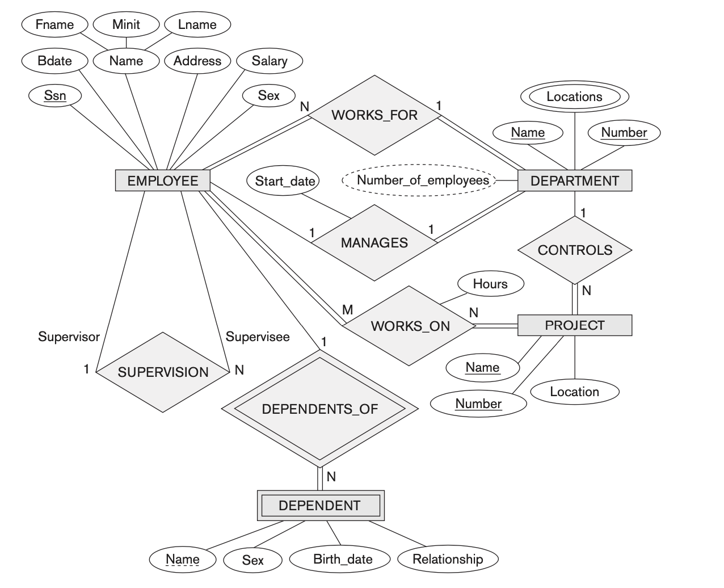
Cardinality Ratios for Binary Relationships
Cardinality ratios for binary relationships are represented on ER diagrams by displaying 1, M, and N on the diamonds

Slide 76
Participation Constraints and Existence Dependencies
The participation constraint specifies whether the existence of an entity depends on its being related to another entity via the relationship type.
Two types of participation constraints: total and partial
Example of Total: If a company policy states that every employee must work for a department, then an employee entity can exist only if it participates in at least one WORKS_FOR relationship instance
The participation of EMPLOYEE in WORKS_FOR is called total participation, meaning that every entity in the total set of employee entities must be related to a department entity via WORKS_FOR
Total participation is also called existence dependency

Slide 77
Participation Constraints and Existence Dependencies
The participation constraint specifies whether the existence of an entity depends on its being related to another entity via the relationship type.
Two types of participation constraints: total and partial
Example of Partial: we do not expect every employee to manage a department, so the participation of EMPLOYEE in the MANAGES relationship type is partial
meaning that some or part of the set of employee entities are related to some department entity via MANAGES, but not necessarily all.

Slide 78
Participation Constraints and Existence Dependencies
In ER diagrams, total participation (or existence dependency) is displayed as a double line connecting the participating entity type to the relationship, whereas partial participation is represented by a single line

Slide 79
Attributes of Relationship Types
Relationship types can also have attributes, similar to those of entity types
Example 1: to record the number of hours per week that a particular employee works on a particular project
Hours
WORKS_ON
EMPLOYEE
PROJECT

Slide 80
Attributes of Relationship Types
Relationship types can also have attributes, similar to those of entity types
Example 2: date on which a manager started managing a department via an attribute Start_date for the MANAGES relationship type
Start_Date
MANAGES
EMPLOYEE
DEPT
*MANAGES is a 1:1 relationship, so every department or employee entity participates in at most one relationship instance.

Slide 81
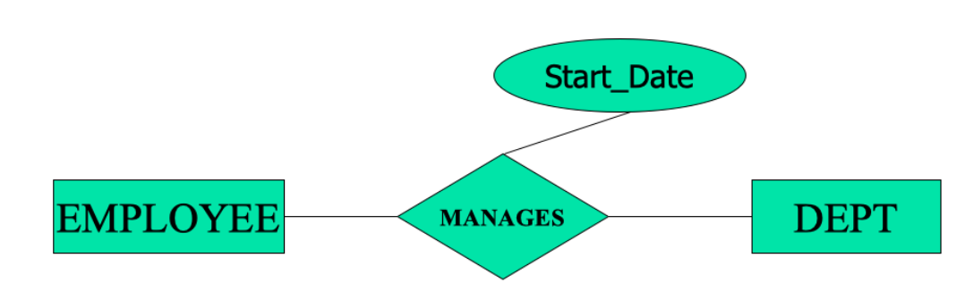
Attributes of Relationship Types - Placement
For 1:1
Attributes can be migrated to one of the participating entity types
Example
“Start_date” can be an attribute of either EMPLOYEE or DEPT
*MANAGES is a 1:1 relationship, so every department or employee entity participates in at most one relationship instance.

Slide 82
Attributes of Relationship Types - Placement
For 1:N
a relationship attribute can be migrated only to the entity type on the N-side of the relationship
Example
“start_date” indicates when an employee started working for a department, should be included as an attribute of EMPLOYEE
START_DATE
WORKS_FOR
EMPLOYEE
DEPT
*each department can be related to any number of employees (N), but an employee can be related to at most one department (1) = N:1 relationship type

Slide 83
Attributes of Relationship Types - Placement
For M:N
a relationship attribute is determined by combination of participating entities and not by single entity
Example:
number of hours per week an employee currently works on a project is determined by an employee-project combination and not separately by either entity.
HOURS
WORKS_ON
EMPLOYEE
PROJECT
*each employee can work on any number of projects (M), and a project can have any number of employees (N) = M:N relationship type

Slide 84
Weak Entity Types

Slide 85
Weak Entity Types
Definition
Entity types that do not have key attributes of their own
They are identified by being related to specific entities from another (strong/owner) entity type
Identifying Relationship
A relationship type that relates a weak entity type to its owner/strong entity type
Participation Constraint (existence dependency)
always has a total participation constraint because it cannot be identified without an owner entity.

Slide 86
Weak Entity Types - Representation
In ERDs, weak entity type and its identifying relationship are distinguished by surrounding their boxes and diamonds with double lines.

Slide 87
Weak Entity Types - Example
DEPENDENT
Keeps track of the dependents of each employee via a 1:N relationship
Attributes: Name, Gender, Birth_Date, Relationship
Uniqueness of Entities
Two dependents of two distinct employees may have the same all attribute values but they are still distinct entities because of being determined by particular employee entity to which each dependent is related to

Slide 88
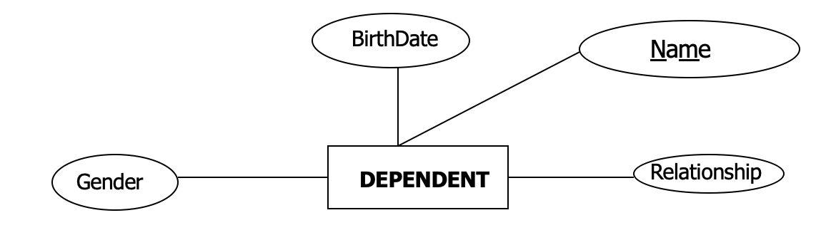
Weak Entity Types – Partial Key
Partial Key
A weak entity type has a partial key, which is the attribute that can uniquely identify weak entities in combination with the data from owner/strong entity
Ensures that no two dependents have same name, the partial key is attached with the key from strong/owner entity
Partial Key is shown as dotted underline.
*In worst case, a composite attribute of all the weak entity’s attributes will be the partial key.

Slide 89
Weak Entity Types – Implementation
Weak entity types can sometimes be represented as complex (composite, multivalued) attributes.
Example:
we could specify a multivalued attribute Dependents for EMPLOYEE, which is a multivalued composite attribute with the component attributes Name, Birth_date, Gender, and Relationship.
Or database designer can choose

Slide 90
Weak Entity Types - Exception
Exception: not every existence dependency results in a weak entity type.
Example: a DRIVER_LICENSE entity cannot exist unless it is related to a PERSON entity, even though it has its own key (License_number) and hence is not a weak entity.
Observation on Above Exception:
consider the available attributes i.e. DRIVER_LICENSE entity has License_number attribute
but any other such entity type having existence dependency may not have such attribute like DEPENDANT do not have attribute like CNIC

Slide 91
Alternative Notations for ER Diagrams – (min,max)
Associates a pair of integer numbers (min, max) with each participation of an entity type E in a relationship type R
where 0 ≤ min ≤ max and max ≥ 1
The numbers mean that for each entity e in E, e must participate in at least min and at most max relationship instances in R at any point in time.
min = 0 implies partial participation, whereas min > 0 implies total participation.

Slide 92
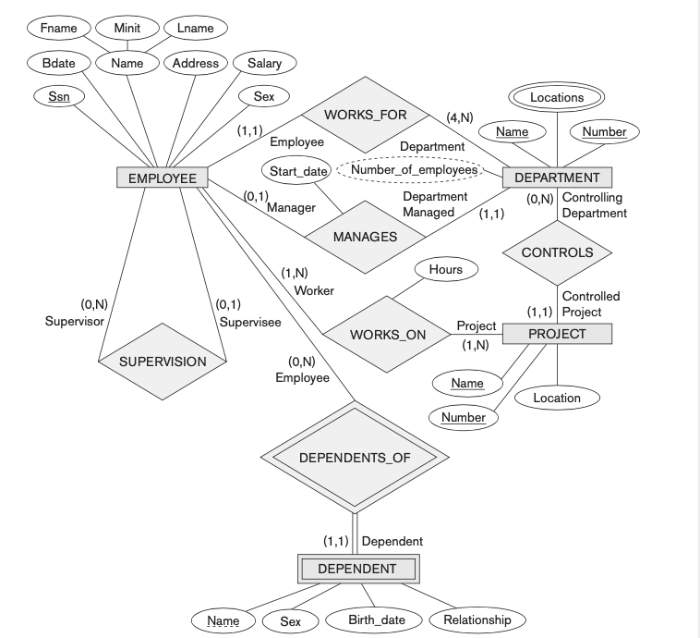
Alternative Notations for ER Diagrams – with (min,max)

Slide 93
Alternative Notations for ER Diagrams – without (min,max)

Slide 94
Relationship Types of Degree Higher than Two
Recap Binary and Ternary Relationships
a relationship type of degree two is binary
relationship type of degree three is ternary

Slide 95
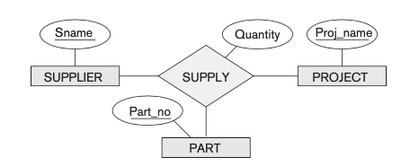
Relationship Types of Degree Higher than Two
Example Ternary Relationship
SUPPLY is a set of relationship instances (s, j, p), where the meaning is that s is a SUPPLIER who is currently supplying a PART p to a PROJECT j.

Slide 96
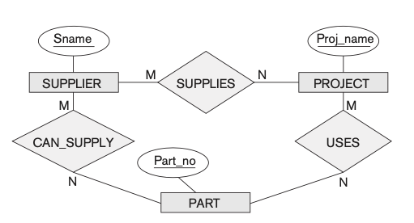
Relationship Types of Degree Higher than Two
Is below A Ternary Relationship ?
The ternary relationship from previous slide is broken as 3 binary relationships

Slide 97
Relationship Types of Degree Higher than Two
Choosing between Binary and Ternary Relationship
often tricky to decide whether a particular relationship should be represented as
a relationship type of degree n or should be
Or broken down into several relationship types of smaller degrees
The designer must base this decision on semantics or meaning of the particular situation being represented.

Slide 98
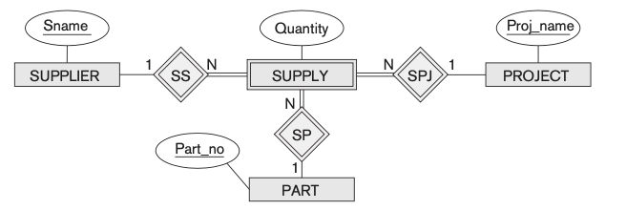
A Variation – Using Weak Entity Type to Show Ternary as Binary Relationship
Some database design tools are based on variations of the ER model that permit only binary relationships
In this case, a ternary relationship such as SUPPLY must be represented as a weak entity type, with no partial key and with three identifying relationships
A weak entity is identified by the combination of its three owner entities from SUPPLIER, PART, and PROJECT.

Slide 99
Converting Weak Entity Type into Regular Entity Type
Add a Surrogate Key
An artificially generated value for each entity
Supply_id could be used for the supply entity type, converting it into a regular entity type.
Supply is now a Regular Entity Type

Slide 100
Converting Weak Entity Type into Regular Entity Type
Refer to other example in figure 3.18 in your text book yourself
Page 90

Slide 101
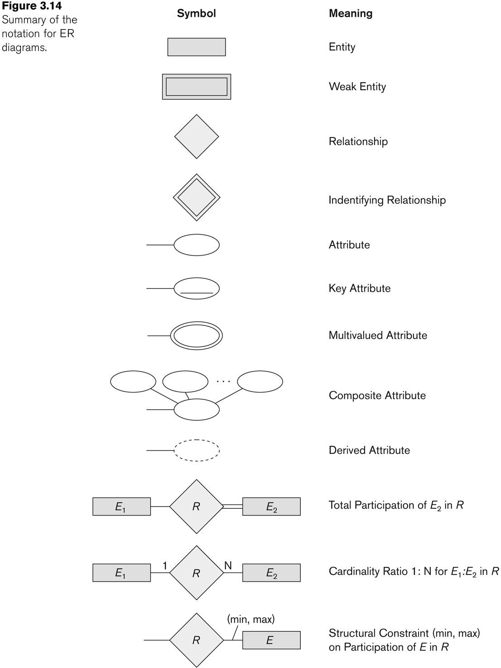
Summary of notation for ER diagrams

Slide 102
Data Modeling Tools
A number of popular tools that cover conceptual modeling and mapping into relational schema design.
Examples: ERWin, S- Designer (Enterprise Application Suite), ER- Studio, etc.
POSITIVES:
Serves as documentation of application requirements, easy user interface - mostly graphics editor support
NEGATIVES:
Most tools lack a proper distinct notation for relationships with relationship attributes
Mostly represent a relational design in a diagrammatic form rather than a conceptual ER-based design
(See Chapter 12 for details)

Slide 103
Some of the Currently Available Automated Database Design Tools
COMPANY | TOOL | FUNCTIONALITY
Embarcadero Technologies | ER Studio | Database Modeling in ER and IDEF1X
 | DB Artisan | Database administration, space and security management
Oracle | Developer 2000/Designer 2000 | Database modeling, application development
Popkin Software | System Architect 2001 | Data modeling, object modeling, process modeling, structured analysis/design
Platinum (Computer Associates) | Enterprise Modeling Suite: Erwin, BPWin, Paradigm Plus | Data, process, and business component modeling
Persistence Inc. | Pwertier | Mapping from O-O to relational model
Rational (IBM) | Rational Rose | UML Modeling & application generation in C++/JAVA
Resolution Ltd. | Xcase | Conceptual modeling up to code maintenance
Sybase | Enterprise Application Suite | Data modeling, business logic modeling
Visio | Visio Enterprise | Data modeling, design/reengineering Visual Basic/C++

Slide 104
Extended Entity-Relationship (EER) Model (in next chapter)
The entity relationship model in its original form did not support the specialization and generalization abstractions
Next chapter illustrates how the ER model can be extended with
Type-subtype and set-subset relationships
Specialization/Generalization Hierarchies
Notation to display them in EER diagrams

Slide 105
Chapter Summary
ER Model Concepts: Entities, attributes, relationships
Constraints in the ER model
Using ER in step-by-step conceptual schema design for the COMPANY database
ER Diagrams - Notation
Alternative Notations – UML class diagrams, others

